Slide 1
IBM Hack Challenge 2022 - Code For A Better Future (Smart Internz)
Problem Statement: Applying AI to Help people improve their lifestyle Project: Disease Prediction
INTRODUCTION
Overview
The system processes the symptoms provided by the user as input and
gives the output as the probability of the disease. So that doctor can treat patients without physical touch.
Purpose
Disease Prediction system is based on predictive modeling predicts the disease of the user on the basis of the symptoms that user provides as an input to the system. The system analyzes the symptoms provided
by the user as input and gives the probability of the disease Asian output Disease Prediction is done by implementing the NaiveiBayes
Classifier. Naive Bayes Classifier calculates the probability of the
disease. With big data growth in biomedical and health care communities, accurate analysis of medical data benefits early disease detection, patient care. By using linear regression and decision tree we are predicting diseases like Diabetes, Malaria, Jaundice, Dengue, and Tuberculosis.
LITERATURE SURVEY
Existing problem
The value of machine learning is rooted in its ability to create accurate
models for disease predication to guide future actions and to discover patterns that we've never seen before.
Propose solution
Machine Learning is an emerging approach that helps in prediction, diagnosis of a disease. This paper depicts the prediction of disease based on symptoms using machine learning. Machine Learning algorithms such as Naive Bayes, Decision Tree and Random Forest are employed on the provided dataset and predict the disease.

Slide 2
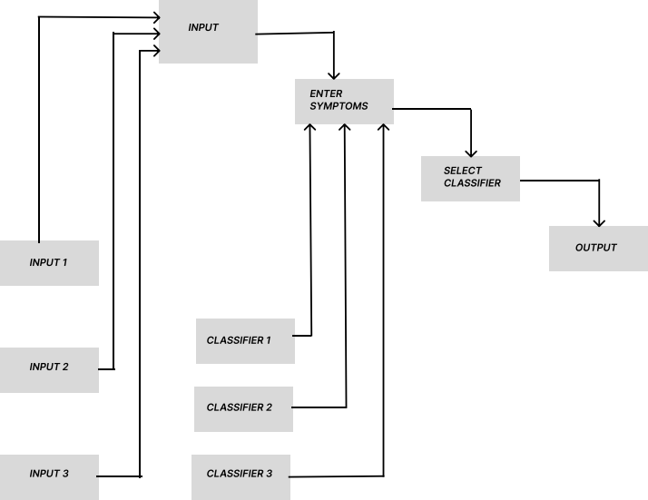
THEORITICAL ANALYSIS
Block Diagram
3.2 Hardware / Software designing
Component | Minimum Requirement
Processor | 64-bit, four-core, 2.5 GHz minimum per core
RAM | 8 GB for developer and evaluation use
Hard Disk | 256 GB
SSD | 256 GB
Experimental Investigations
A observation was carried out that, the people are not always completely assured about the disease they are suffering from. They sometimes misunderstood the symptoms they have. And nowadays some doctors have a greed of money due to which they charge unnecessarily o their patient. Due to this reason financially weaker people sometimes have to suffer a lot. So, to overcome such issues we have come up with our idea.

Slide 3
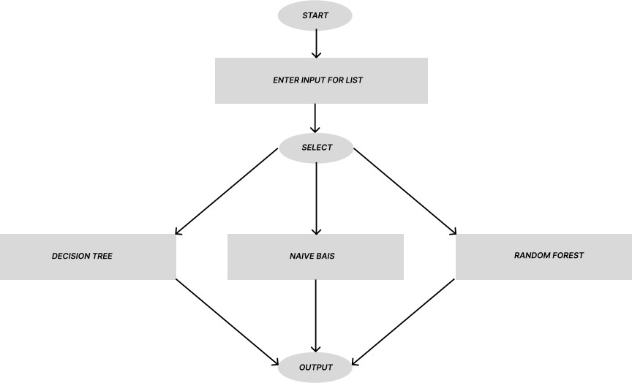
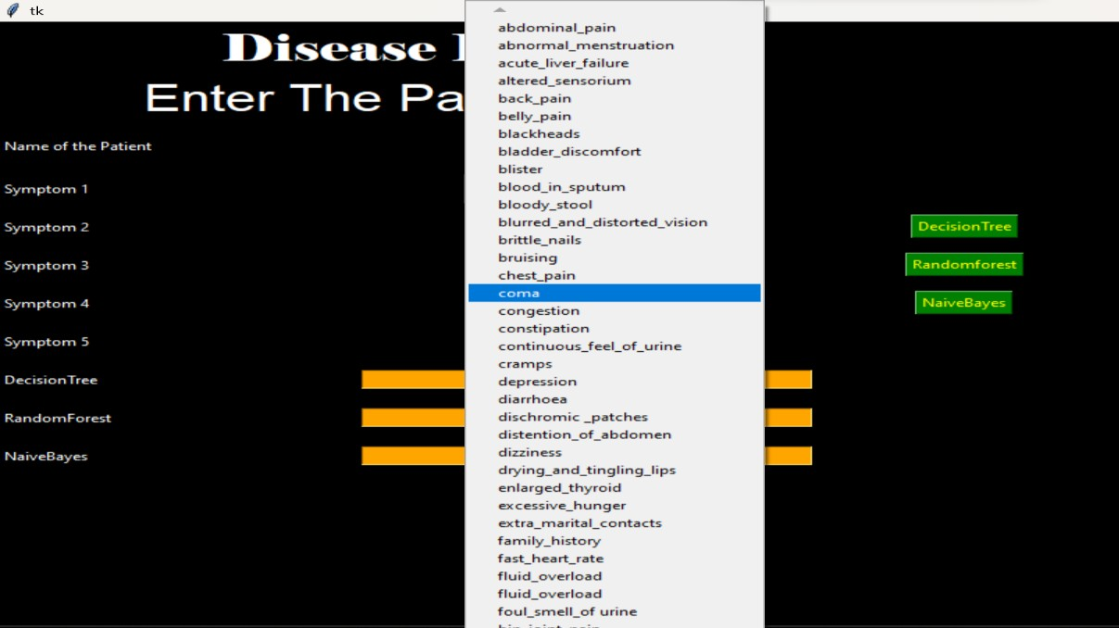
5. Flowchart
6. Result
Output: Various Symptoms showing
Various Symptoms showing

Slide 4
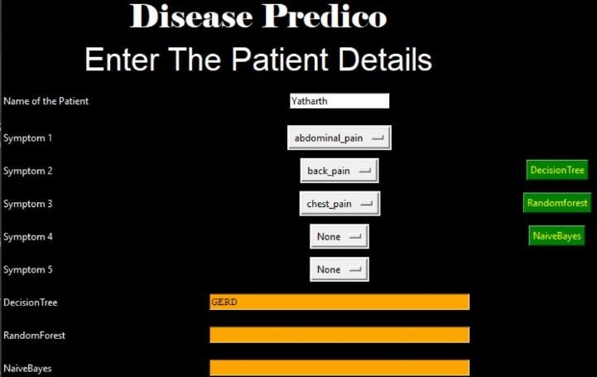
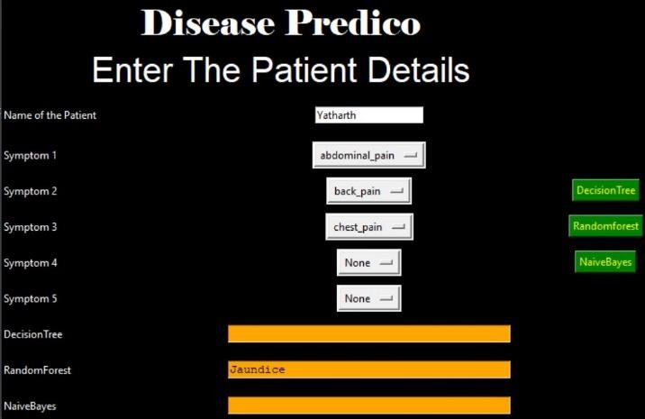

Output: Test Case-1
Fig:1.1 - Using DecisionTree Algorithm
Fig:1.2 - Using RandomForest Algorithm
Fig:1.3 - Using NaiveBayes Algorithm

Slide 5
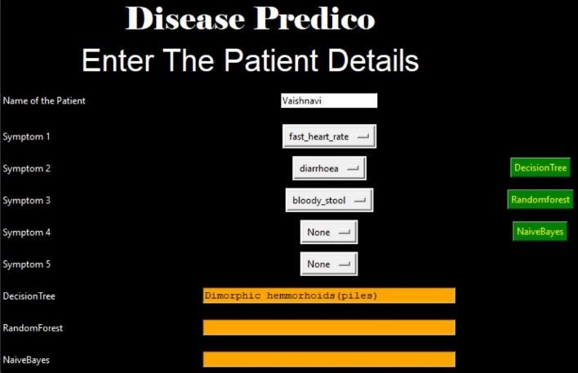
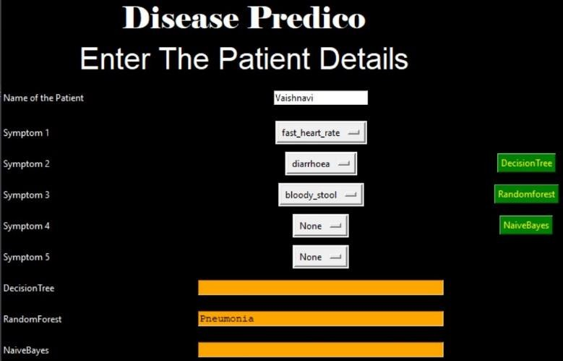
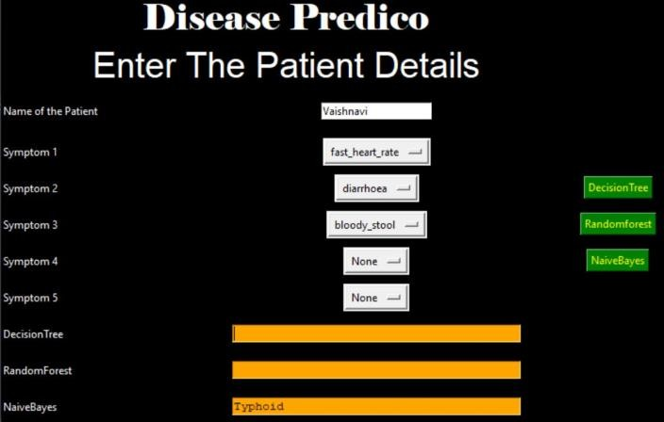
Output: Test Case-2
Fig:2.1 - Using DecisionTree Algorithm
Fig:2.2 - Using RandomForest Algorithm
Fig:2.3 - Using NaiveBayes Algorithm

Slide 6
Advantages & Disadvantages
Advantages:
It can identify patients at risk of disease or health conditions.
Increased accuracy for effective disease diagnosis.
Handles roughest(enormous) amount of data using DecisionTree, randomforest and NaiveBayes algorithm and feature selection.
Reduce the time complexity of doctors.
Cost effective for patients.
Disadvantages:
Cannot have datasets for patient records.
Not Providing any medicines details regarding symptoms.
Maybe patient confused to showing three types of result.
Applications:
The Data is used when planning how to control and prevent disease in the community.
Model has been used to figured out Symptoms anywhere doesn’t matter.
Public health center
Health services research
During Medical Studies
Conclusion:
Concluding, we would like to add that health is wealth, healthy min in healthy body. So, health is much essential in one’s life. One should be aware of the symptoms if he/she is suffering from. Delaying it might cause a severe effects in future. Hence, rapid action must be taken.
Future Scope
In the upcoming future health is going to be a major issue. We also observe that some diseases can transmit through physical contact also.

Slide 7
Sometimes when doctor checks us, this might happen that the disease of patient who came before you, might be transferred to your body as well. Hence care should be taken. So, due to this reason our project idea will overcome this issue.
We will try to collaborate with the hospitals for this. A small change will definitely save lots of lives.
Bibilography
None. Whole project is made from scratch.
APPENDIX
A. Souce Code
from tkinter import * import numpy as np import pandas as pd
# from gui_stuff import *
l1=['back_pain','constipation','abdominal_pain','diarrhoea','mild_fever','y ellow_urine', 'yellowing_of_eyes','acute_liver_failure','fluid_overload','swelling_of_sto mach', 'swelled_lymph_nodes','malaise','blurred_and_distorted_vision','phlegm','th roat_irritation', 'redness_of_eyes','sinus_pressure','runny_nose','congestion','chest_pain',' weakness_in_limbs', 'fast_heart_rate','pain_during_bowel_movements','pain_in_anal_region','bloo dy_stool', 'irritation_in_anus','neck_pain','dizziness','cramps','bruising','obesity', 'swollen_legs', 'swollen_blood_vessels','puffy_face_and_eyes','enlarged_thyroid','brittle_n ails', 'swollen_extremeties','excessive_hunger','extra_marital_contacts','drying_a nd_tingling_lips', 'slurred_speech','knee_pain','hip_joint_pain','muscle_weakness','stiff_neck ','swelling_joints', 'movement_stiffness','spinning_movements','loss_of_balance','unsteadiness', 'weakness_of_one_body_side','loss_of_smell','bladder_discomfort','foul_smel l_of urine', 'continuous_feel_of_urine','passage_of_gases','internal_itching','toxic_loo k_(typhos)', 'depression','irritability','muscle_pain','altered_sensorium','red_spots_ov er_body','belly_pain',
'abnormal_menstruation','dischromic
_patches','watering_from_eyes','increased_appetite','polyuria','family_hist ory','mucoid_sputum', 'rusty_sputum','lack_of_concentration','visual_disturbances','receiving_blo od_transfusion', 'receiving_unsterile_injections','coma','stomach_bleeding','distention_of_a bdomen',

Slide 8
'history_of_alcohol_consumption','fluid_overload','blood_in_sputum','promin ent_veins_on_calf', 'palpitations','painful_walking','pus_filled_pimples','blackheads','scurrin g','skin_peeling', 'silver_like_dusting','small_dents_in_nails','inflammatory_nails','blister'
,'red_sore_around_nose', 'yellow_crust_ooze']
disease=['Fungal infection','Allergy','GERD','Chronic cholestasis','Drug Reaction',
'Peptic ulcer diseae','AIDS','Diabetes','Gastroenteritis','Bronchial
Asthma','Hypertension',
' Migraine','Cervical spondylosis',
'Paralysis (brain hemorrhage)','Jaundice','Malaria','Chicken pox','Dengue','Typhoid','hepatitis A',
'Hepatitis B','Hepatitis C','Hepatitis D','Hepatitis E','Alcoholic
hepatitis','Tuberculosis',
'Common Cold','Pneumonia','Dimorphic hemmorhoids(piles)', 'Heartattack','Varicoseveins','Hypothyroidism','Hyperthyroidism','Hypoglyce mia','Osteoarthristis',
'Arthritis','(vertigo) Paroymsal Positional Vertigo','Acne','Urinary tract infection','Psoriasis',
'Impetigo']
l2=[]
for x in range(0,len(l1)): l2.append(0)
# TESTING DATA df
df=pd.read_csv("Training.csv")
df.replace({'prognosis':{'Fungal infection':0,'Allergy':1,'GERD':2,'Chronic cholestasis':3,'Drug Reaction':4,
'Peptic ulcer diseae':5,'AIDS':6,'Diabetes ':7,'Gastroenteritis':8,'Bronchial Asthma':9,'Hypertension ':10, 'Migraine':11,'Cervical spondylosis':12,
'Paralysis (brain hemorrhage)':13,'Jaundice':14,'Malaria':15,'Chicken pox':16,'Dengue':17,'Typhoid':18,'hepatitis A':19,
'Hepatitis B':20,'Hepatitis C':21,'Hepatitis D':22,'Hepatitis E':23,'Alcoholic hepatitis':24,'Tuberculosis':25,
'Common Cold':26,'Pneumonia':27,'Dimorphic hemmorhoids(piles)':28,'Heart
attack':29,'Varicose veins':30,'Hypothyroidism':31, 'Hyperthyroidism':32,'Hypoglycemia':33,'Osteoarthristis':34,'Arthritis':35, '(vertigo) Paroymsal Positional Vertigo':36,'Acne':37,'Urinary tract infection':38,'Psoriasis':39,
'Impetigo':40}},inplace=True)
X= df[l1]
y = df[["prognosis"]] np.ravel(y)
# print(y)
# TRAINING DATA tr
tr=pd.read_csv("Testing.csv")
tr.replace({'prognosis':{'Fungal infection':0,'Allergy':1,'GERD':2,'Chronic cholestasis':3,'Drug Reaction':4,

Slide 9
'Peptic ulcer diseae':5,'AIDS':6,'Diabetes ':7,'Gastroenteritis':8,'Bronchial Asthma':9,'Hypertension ':10, 'Migraine':11,'Cervical spondylosis':12,
'Paralysis (brain hemorrhage)':13,'Jaundice':14,'Malaria':15,'Chicken pox':16,'Dengue':17,'Typhoid':18,'hepatitis A':19,
'Hepatitis B':20,'Hepatitis C':21,'Hepatitis D':22,'Hepatitis
E':23,'Alcoholic hepatitis':24,'Tuberculosis':25,
'Common Cold':26,'Pneumonia':27,'Dimorphic hemmorhoids(piles)':28,'Heart attack':29,'Varicose veins':30,'Hypothyroidism':31, 'Hyperthyroidism':32,'Hypoglycemia':33,'Osteoarthristis':34,'Arthritis':35, '(vertigo) Paroymsal Positional Vertigo':36,'Acne':37,'Urinary tract infection':38,'Psoriasis':39,
'Impetigo':40}},inplace=True)
X_test= tr[l1]
y_test = tr[["prognosis"]] np.ravel(y_test)
#
def DecisionTree():
from sklearn import tree
clf3 = tree.DecisionTreeClassifier() tree
clf3 = clf3.fit(X,y)
# empty model of the decision
# calculating accuracy
from sklearn.metrics import accuracy_score y_pred=clf3.predict(X_test) print(accuracy_score(y_test, y_pred)) print(accuracy_score(y_test, y_pred,normalize=False))
#
psymptoms = [Symptom1.get(),Symptom2.get(),Symptom3.get(),Symptom4.get(),Symptom5.get()
]
for k in range(0,len(l1)): # print (k,)
for z in psymptoms: if(z==l1[k]):
l2[k]=1
inputtest = [l2]
predict = clf3.predict(inputtest) predicted=predict[0]
h='no'
for a in range(0,len(disease)): if(predicted == a):
h='yes'
break
if (h=='yes'):
t1.delete("1.0", END) t1.insert(END, disease[a])
else:

Slide 10
t1.delete("1.0", END) t1.insert(END, "Not Found")
def randomforest():
from sklearn.ensemble import RandomForestClassifier clf4 = RandomForestClassifier()
clf4 = clf4.fit(X,np.ravel(y))
# calculating accuracy from sklearn.metrics import accuracy_score
y_pred=clf4.predict(X_test) print(accuracy_score(y_test, y_pred)) print(accuracy_score(y_test, y_pred,normalize=False))
#
psymptoms = [Symptom1.get(),Symptom2.get(),Symptom3.get(),Symptom4.get(),Symptom5.get()
]
for k in range(0,len(l1)): for z in psymptoms:
if(z==l1[k]):
l2[k]=1
inputtest = [l2]
predict = clf4.predict(inputtest) predicted=predict[0]
h='no'
for a in range(0,len(disease)): if(predicted == a):
h='yes'
break
if (h=='yes'):
t2.delete("1.0", END) t2.insert(END, disease[a])
else:
t2.delete("1.0", END) t2.insert(END, "Not Found")
def NaiveBayes():
from sklearn.naive_bayes import GaussianNB gnb = GaussianNB() gnb=gnb.fit(X,np.ravel(y))
# calculating accuracy from sklearn.metrics import accuracy_score
y_pred=gnb.predict(X_test) print(accuracy_score(y_test, y_pred)) print(accuracy_score(y_test, y_pred,normalize=False))
#
psymptoms = [Symptom1.get(),Symptom2.get(),Symptom3.get(),Symptom4.get(),Symptom5.get()
]
for k in range(0,len(l1)):

Slide 11
for z in psymptoms: if(z==l1[k]):
l2[k]=1
inputtest = [l2]
predict = gnb.predict(inputtest) predicted=predict[0]
h='no'
for a in range(0,len(disease)): if(predicted == a):
h='yes'
break
if (h=='yes'):
t3.delete("1.0", END) t3.insert(END, disease[a])
else:
t3.delete("1.0", END) t3.insert(END, "Not Found")
# gui_stuff
root = Tk()
root.configure(background='black') # here you can change backgroud colour
# entry variables Symptom1 = StringVar() Symptom1.set(None) Symptom2 = StringVar() Symptom2.set(None) Symptom3 = StringVar() Symptom3.set(None) Symptom4 = StringVar() Symptom4.set(None) Symptom5 = StringVar() Symptom5.set(None) Name = StringVar()
# Heading all frontend part is here you can change design here
w2 = Label(root, justify=CENTER, text="Disease Predico", fg="white", bg="black")
w2.config(font=("Elephant", 30))
w2.grid(row=1, column=0, columnspan=2, padx=100)
w2 = Label(root, justify=CENTER, text="enter your details", fg="white", bg="black")
w2.config(font=("Aharoni", 30))
w2.grid(row=2, column=0, columnspan=2, padx=100)
# labels
NameLb = Label(root, text="Name of the Patient", fg="white", bg="black") NameLb.grid(row=6, column=0, pady=15, sticky=W)
S1Lb = Label(root, text="Symptom 1", fg="white", bg="black") S1Lb.grid(row=7, column=0, pady=10, sticky=W)
S2Lb = Label(root, text="Symptom 2", fg="white", bg="black") S2Lb.grid(row=8, column=0, pady=10, sticky=W)

Slide 12
S3Lb = Label(root, text="Symptom 3", fg="white", bg="black") S3Lb.grid(row=9, column=0, pady=10, sticky=W)
S4Lb = Label(root, text="Symptom 4", fg="white", bg="black") S4Lb.grid(row=10, column=0, pady=10, sticky=W)
S5Lb = Label(root, text="Symptom 5", fg="white", bg="black") S5Lb.grid(row=11, column=0, pady=10, sticky=W)
lrLb = Label(root, text="DecisionTree", fg="white", bg="black") lrLb.grid(row=15, column=0, pady=10,sticky=W)
destreeLb = Label(root, text="RandomForest", fg="white", bg="black") destreeLb.grid(row=17, column=0, pady=10, sticky=W)
ranfLb = Label(root, text="NaiveBayes", fg="white", bg="black") ranfLb.grid(row=19, column=0, pady=10, sticky=W)
# entries
OPTIONS = sorted(l1)
NameEn = Entry(root, textvariable=Name) NameEn.grid(row=6, column=1)
S1En = OptionMenu(root, Symptom1,*OPTIONS) S1En.grid(row=7, column=1)
S2En = OptionMenu(root, Symptom2,*OPTIONS) S2En.grid(row=8, column=1)
S3En = OptionMenu(root, Symptom3,*OPTIONS) S3En.grid(row=9, column=1)
S4En = OptionMenu(root, Symptom4,*OPTIONS) S4En.grid(row=10, column=1)
S5En = OptionMenu(root, Symptom5,*OPTIONS) S5En.grid(row=11, column=1)
dst = Button(root, text="DecisionTree", command=DecisionTree,bg="green",fg="yellow") dst.grid(row=8, column=3)
rnf = Button(root, text="Randomforest", command=randomforest,bg="green",fg="yellow") rnf.grid(row=9, column=3,padx=10)
lr = Button(root, text="NaiveBayes", command=NaiveBayes,bg="green",fg="yellow") lr.grid(row=10, column=3,padx=10)
#textfileds
t1 = Text(root, height=1, width=40,bg="orange",fg="black") t1.grid(row=15, column=1, padx=10)
t2 = Text(root, height=1, width=40,bg="orange",fg="black") t2.grid(row=17, column=1 , padx=10)
t3 = Text(root, height=1, width=40,bg="orange",fg="black")

Slide 13
t3.grid(row=19, column=1 , padx=10)
root.mainloop()
THE END

